Slide 1
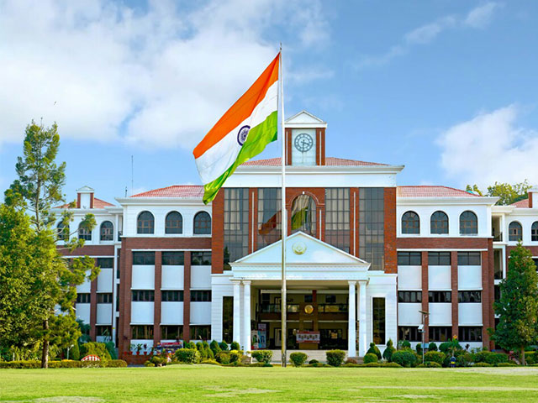




5th International Conference On Innovative Sustainable Computational Technologies
24-25 July 2026
Organized by
Dept. of Computer Science & Engineering
Dept. of Electrical Engineering
Graphic Era deemed to be University Dehradun
Paper Id:
Paper Title:
Presenter Name
Sponsored by:

Slide 2
bvbvbvbvbContents
Abstract
Introduction
Literature Survey
Problem Definition
Proposed Work
Methodology & Implementation
Results & Discussions
Conclusions
References

Slide 3
Abstract

Slide 4
Introduction

Slide 5
Literature Survey

Slide 6
PProblem Definition

Slide 7
Proposed Work

Slide 8
Methodology & Implementation

Slide 9
Results & Discussion

Slide 10
CConclusion

Slide 11
References

